Slide 1
My Journal To Python
Name: 麥聖嬰
Teacher: My Dear Great Teacher

Slide 2
AGENDA
Python
Input and output: input() and print()
Data types: numeric, strings, list , dict
Operators ON data type:
CONTROLS : IF- | IF –ELSIF |-F-ELSE
LOOP: FOR |WHILE | RANGE() | BREAK | CONTINUE
FUNCTION:
PARAMETERS(ARGUMETNS)
RECURSIVE FUNCTION
LAMBDA FUNCTION

Slide 3
Python
Python is a popular programming language. It was created by Guido van Rossum, and released in 1991.
It is used for:
web development (server-side),
software development,
mathematics,
system scripting.

Slide 4
What can Python do?
Python can be used on a server to create web applications.
Python can be used alongside software to create workflows.
Python can connect to database systems. It can also read and modify files.
Python can be used to handle big data and perform complex mathematics.
Python can be used for rapid prototyping, or for production-ready software development.

Slide 5
Why Python?
Python works on different platforms (Windows, Mac, Linux, Raspberry Pi, etc).
Python has a simple syntax similar to the English language.
Python has syntax that allows developers to write programs with fewer lines than some other programming languages.
Python runs on an interpreter system, meaning that code can be executed as soon as it is written. This means that prototyping can be very quick.
Python can be treated in a procedural way, an object-oriented way or a functional way.

Slide 6

This is how Python Works

Slide 7
INPUT AND OUTPUT

Slide 8
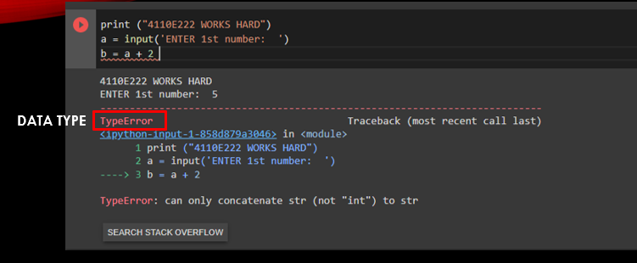
INPUT AND OUTPUT

Slide 9
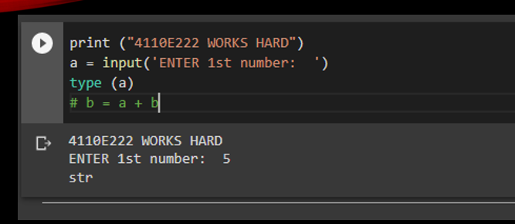
INPUT AND OUTPUT

Slide 10
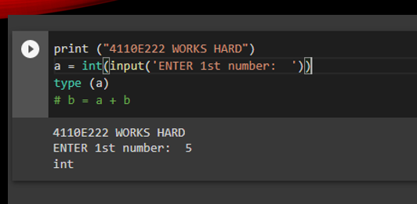
INPUT AND OUTPUT

Slide 11
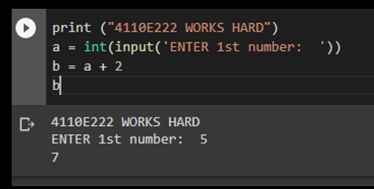
INPUT AND OUTPUT

Slide 12
input() and print()

Slide 13
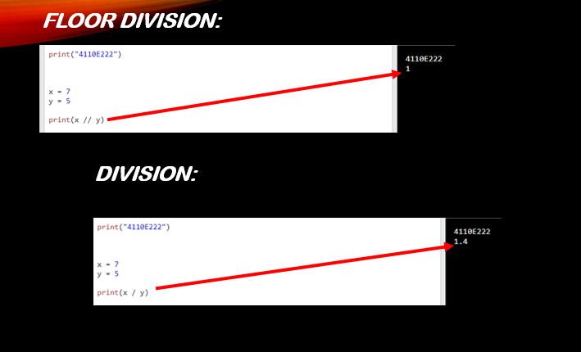
input() and print()

Slide 14
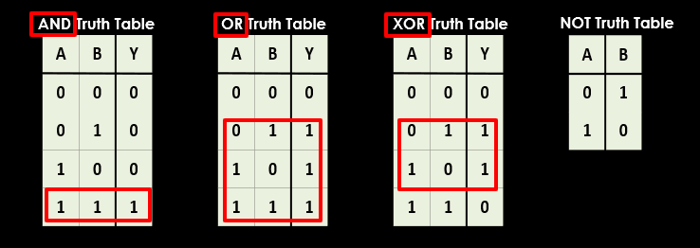
input() and print()

Slide 15
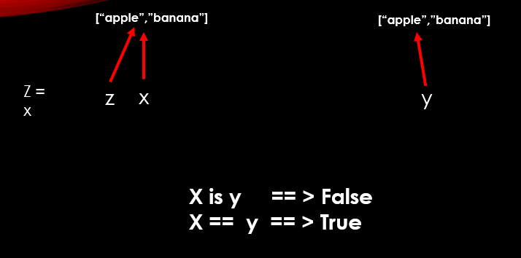
input() and print()

Slide 16
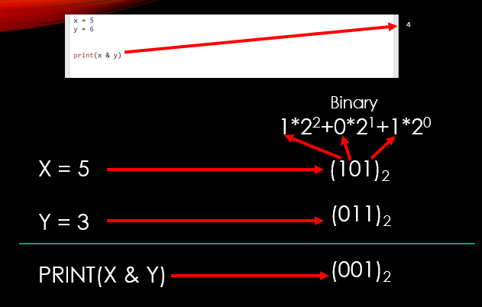
input() and print()

Slide 17
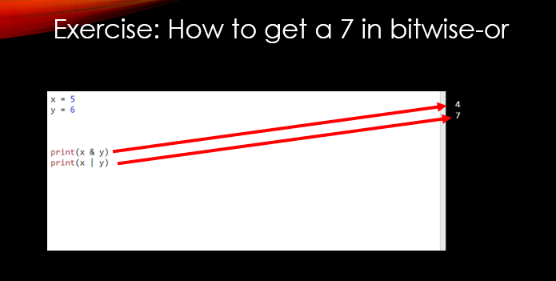
input() and print()

Slide 18
Data Types

Slide 19
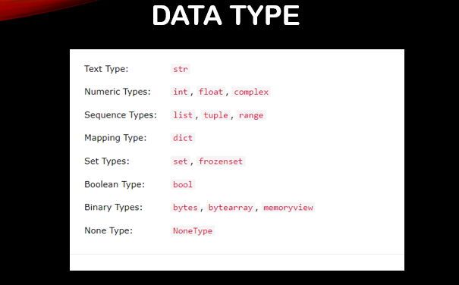
Data Types

Slide 20
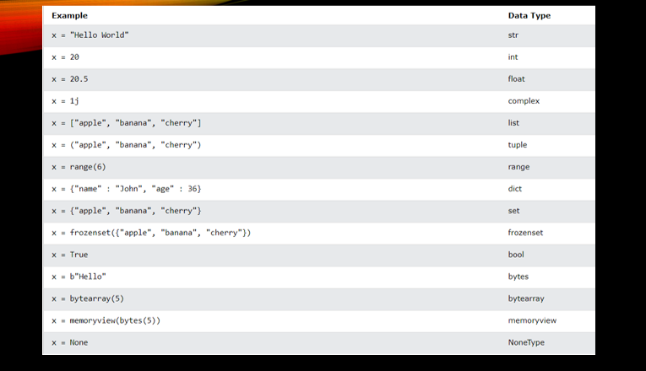
Data Types

Slide 21
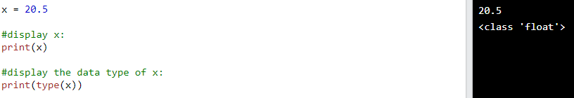
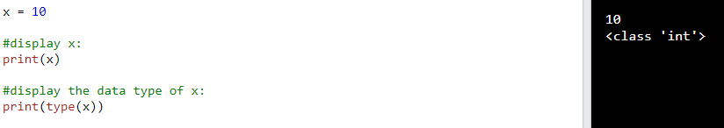
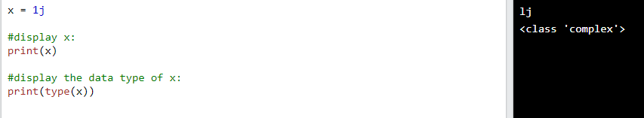
Numeric int
Numeric Float
Numeric Complex

Slide 22
Python Strings

Slide 23
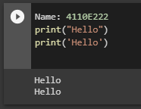
Python Strings
Strings
Strings in python are surrounded by either single quotation marks, or double quotation marks.
double quotation marks
single quotation marks

Slide 24
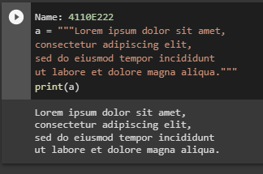
Multiline Strings
You can assign a multiline string to a variable by using three quotes:
Three quotes

Slide 25
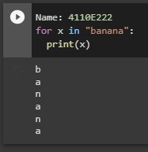
Looping Through a String
Since strings are arrays, we can loop through the characters in a string, with a for loop.

Slide 26
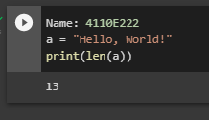
String Length
To get the length of a string, use the len() function.
len() function

Slide 27
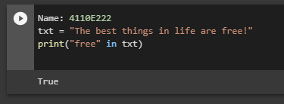
Check String
Since strings are arrays, we can loop through the characters in a string, with a for loop.

Slide 28
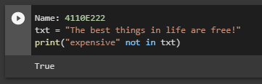
Check if NOT
To check if a certain phrase or character is NOT present in a string, we can use the keyword not in.

Slide 29
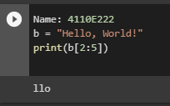
Python - Slicing Strings
Slicing
You can return a range of characters by using the slice syntax.

Slide 30
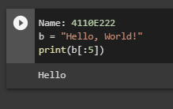
Slice From the Start
By leaving out the start index, the range will start at the first character:

Slide 31
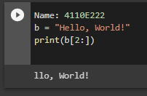
Slice To the End
By leaving out the end index, the range will go to the end:

Slide 32
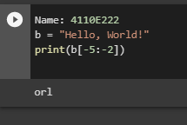
Negative Indexing
Use negative indexes to start the slice from the end of the string:

Slide 33
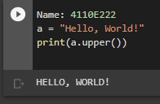
Python - Modify Strings
Upper Case
The upper() method returns the string in upper case

Slide 34
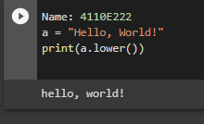
Lower Case
The lower() method returns the string in lower case:

Slide 35
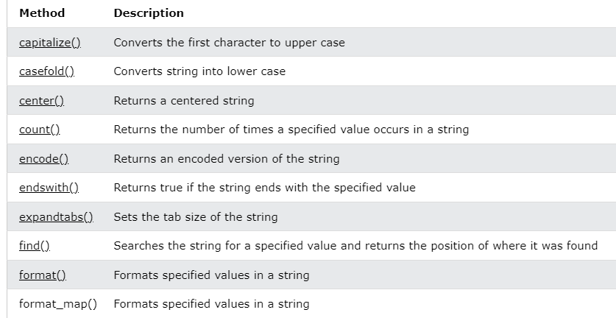
Python - String Methods
String Methods
Python has a set of built-in methods that you can use on strings.

Slide 36
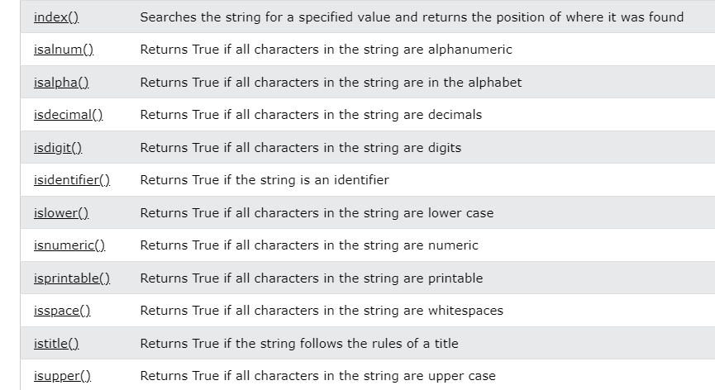
Python - String Methods

Slide 37
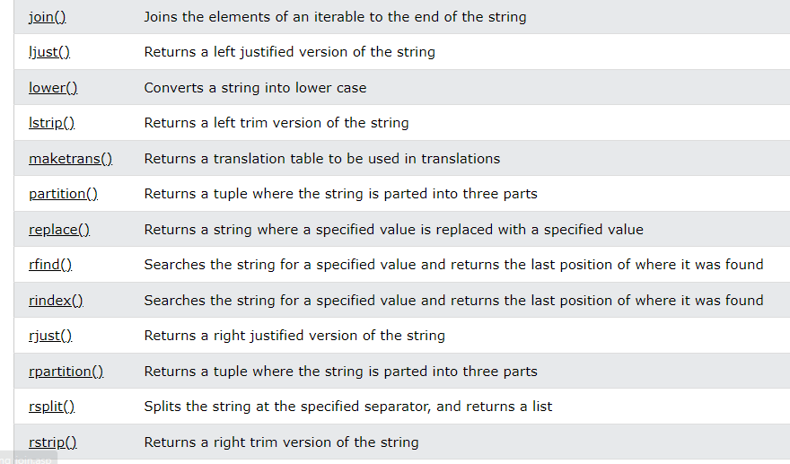
Python - String Methods

Slide 38
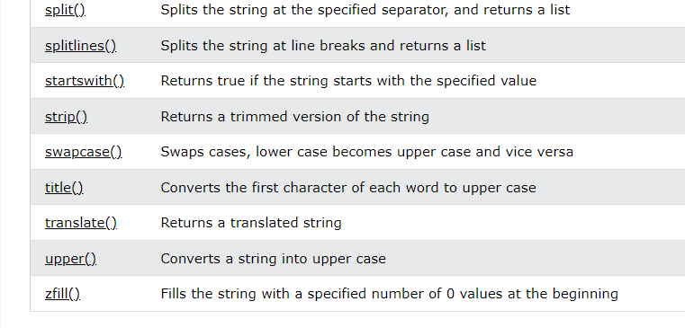
Python - String Methods

Slide 39
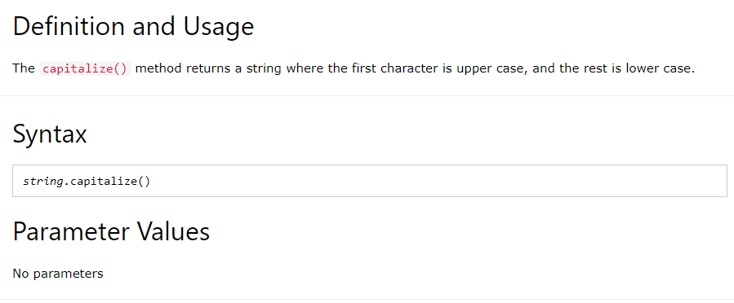
Python String
capitalize() Method

Slide 40
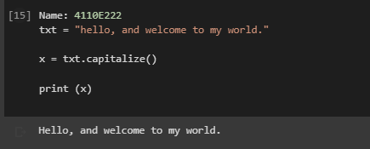
Example:
Upper case the first letter in this sentence:

Slide 41
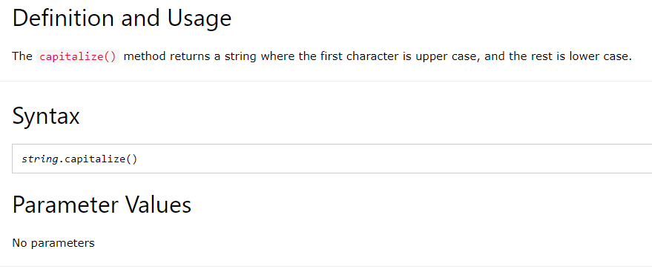
Python String
Case fold() Method

Slide 42
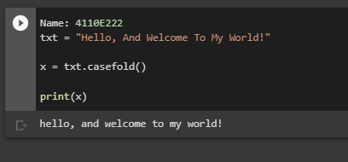
Example:
Make the string lower case:

Slide 43
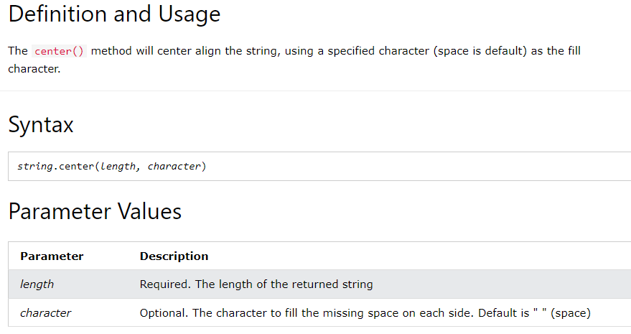
Python String
center() Method

Slide 44
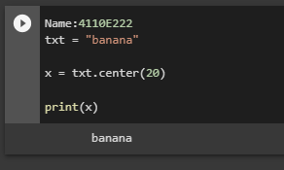
Example:
Print the word "banana", taking up the space of 20 characters, with "banana" in the middle:

Slide 45
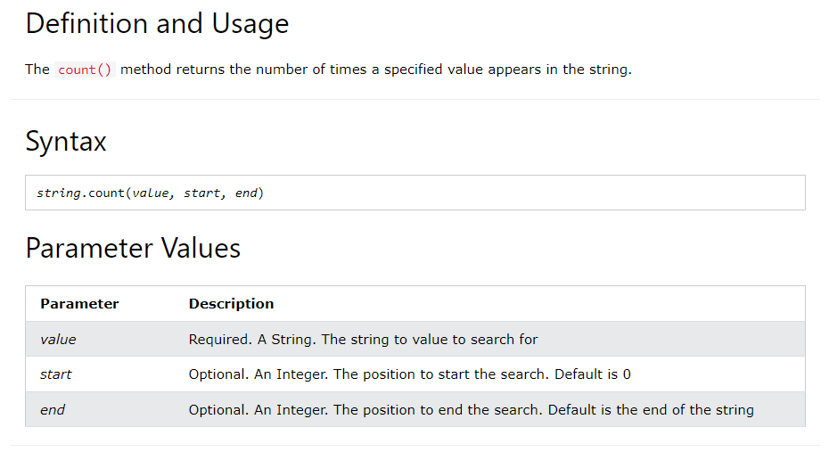
Python String
count() Method

Slide 46
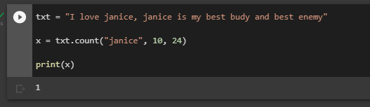
Example:
Search from position 10 to 24:

Slide 47
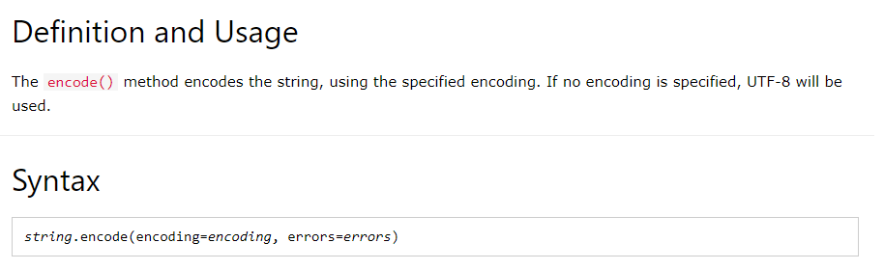
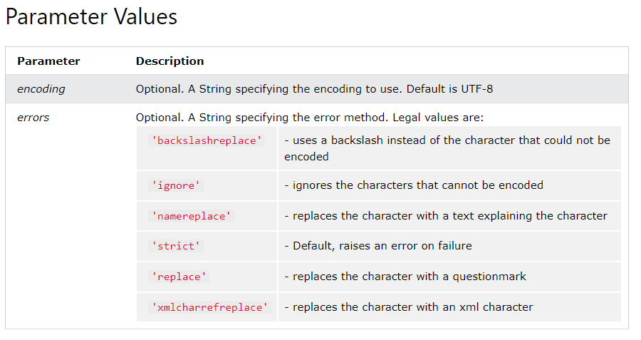
Python String
encode() Method

Slide 48
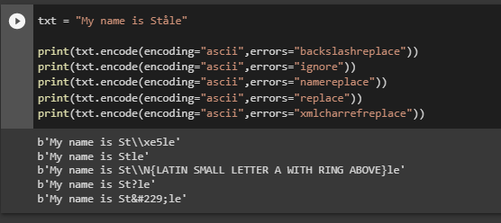
Example:
These examples uses ascii encoding, and a character that cannot be encoded, showing the result with different errors:

Slide 49
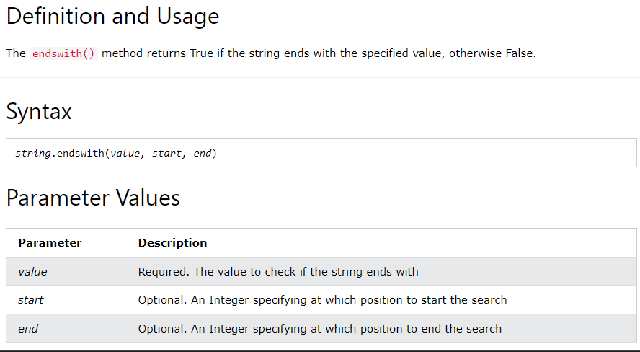
Python String
ends with() Method

Slide 50
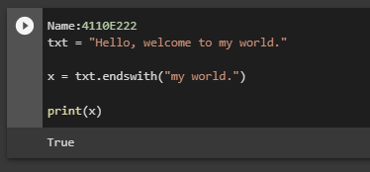
Example:
Check if the string ends with the phrase "my world.":

Slide 51
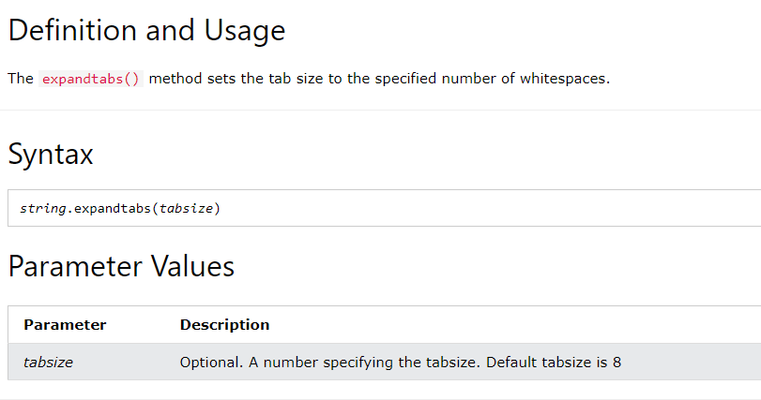
Python String
Exp and tabs() Method

Slide 52
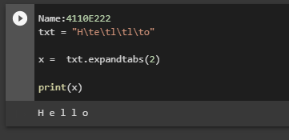
Example:
Set the tab size to 2 whitespaces:

Slide 53
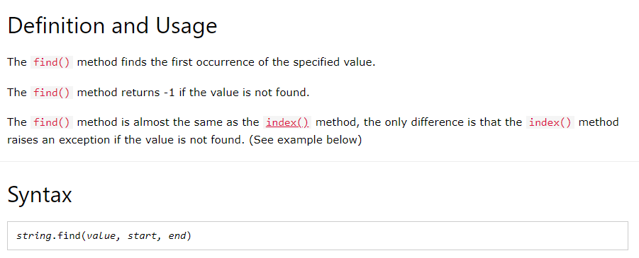
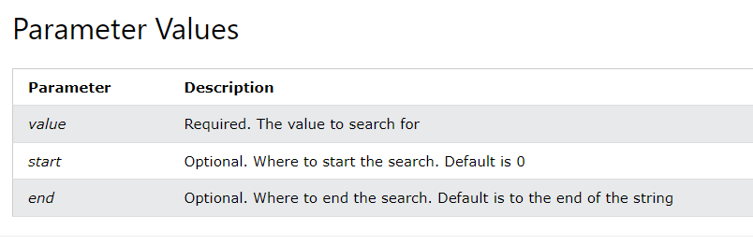
Python String
find() Method

Slide 54
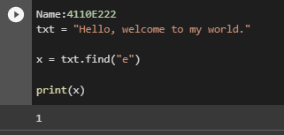
Example:
Where in the text is the first occurrence of the letter "e"?:

Slide 55
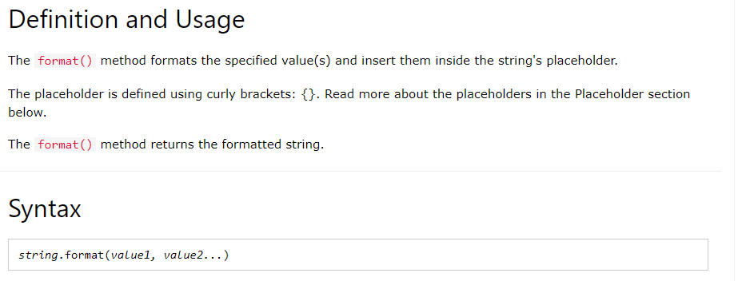
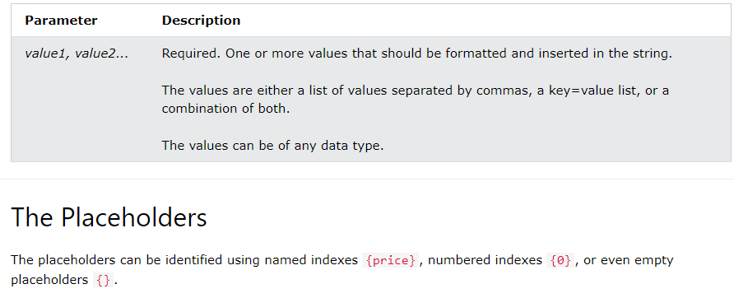
Python String
format() Method

Slide 56

Example:
Using different placeholder values:

Slide 57


Python String
index() Method

Slide 58

Example:
Where in the text is the first occurrence of the letter "e"?:

Slide 59

Python String
isalnum() Method

Slide 60

Example:
Check if all the characters in the text is alphanumeric:

Slide 61

Python String
isalpha() Method

Slide 62

Example:
Check if all the characters in the text is alphabetic:

Slide 63

Python String
isdecimal() Method

Slide 64

Example:
Check if all the characters in the unicode are decimals:

Slide 65

Python String
isdigit() Method

Slide 66

Example:
Check if all the characters in the text are digits:

Slide 67

Python String
isidentifier() Method

Slide 68

Example:
Check if the strings are valid identifiers:

Slide 69

Python String
islower() Method

Slide 70

Example:
Check if all the characters in the texts are in lower case:

Slide 71

Python String
isnumeric() Method

Slide 72

Example:
Check if the characters are numeric:

Slide 73

Python String
isprintable() Method

Slide 74

Example:
Check if all the characters in the text are printable:

Slide 75

Python String
isspace() Method

Slide 76

Example:
Check if all the characters in the text are whitespaces:

Slide 77

Python String ]
istitle() Method

Slide 78

Example:
Check if each word start with an upper case letter:

Slide 79

Python String
isupper() Method

Slide 80

Example:
Check if all the characters in the texts are in upper case:

Slide 81

Python String
join() Method

Slide 82

Example:
Join all items in a dictionary into a string, using the word "TEST" as separator:

Slide 83

Python String
ljust() Method

Slide 84

Example:
Using the letter "O" as the padding character:

Slide 85

Python String
lower() Method

Slide 86

Example:
Lower case the string:

Slide 87

Python String
lstrip() Method

Slide 88

Example:
Remove the leading characters:

Slide 89


Python String
maketrans() Method

Slide 90

Example:
Create a mapping table, and use it in the translate() method to replace any "S" characters with a "P" character:

Slide 91


Python String
partition() Method

Slide 92

Example:
Search for the word "bananas", and return a tuple with three elements:
1 - everything before the "match" 2 - the "match" 3 - everything after the "match"

Slide 93


Python String
replace() Method

Slide 94

Example:
Replace the word "bananas":

Slide 95

Python String
rfind() Method

Slide 96

Example:
Where in the text is the last occurrence of the string "casa"?:

Slide 97


Python String
rindex() Method

Slide 98

Example:
Where in the text is the last occurrence of the string "casa"?:

Slide 99

Python String
rjust() Method

Slide 100

Example:
Return a 20 characters long, right justified version of the word "banana":

Slide 101

Python String
rpartition() Method

Slide 102

Example:
If the specified value is not found, the rpartition() method returns a tuple containing: 1 - an empty string, 2 - an empty string, 3 - the whole string:

Slide 103


Python String
rsplit() Method

Slide 104

Example:
Split the string into a list with maximum 2 items:

Slide 105

Python String
rstrip() Method

Slide 106

Example:
Remove the trailing characters if they are commas, s, q, or w:

Slide 107


Python String
split() Method

Slide 108

Example:
Split the string, using comma, followed by a space, as a separator:

Slide 109

Python String
splitlines() Method

Slide 110

Example:
Split the string, but keep the line breaks:

Slide 111

Python String
startswith() Method

Slide 112

Example:
Check if position 7 to 20 starts with the characters "wel":

Slide 113

Python String
strip() Method

Slide 114

Example:
Remove the leading and trailing characters:

Slide 115

Python String
swapcase() Method

Slide 116

Example:
Make the lower case letters upper case and the upper case letters lower case:

Slide 117

Python String
title() Method

Slide 118

Example:
Make the first letter in each word upper case:

Slide 119

Python String
translate() Method

Slide 120

Example:
Use a mapping table to replace "S" with "P":

Slide 121

Python String
upper() Method

Slide 122

Example:
Upper case the string:

Slide 123

Python String
zfill() Method

Slide 124

Example:
Fill the strings with zeros until they are 10 characters long:

Slide 125

Python Lists
Lists are used to store multiple items in a single variable.
Lists are one of 4 built-in data types in Python used to store collections of data, the other 3 are Tuple, Set, and Dictionary, all with different qualities and usage.
Lists are created using square brackets:
square brackets []

Slide 126


Python - Access List Items
List items are indexed and you can access them by referring to the index number:
index number

Slide 127

Negative Indexing
Negative indexing means start from the end
-1 refers to the last item, -2 refers to the second last item etc.
-2
-1

Slide 128


Range of Indexes
You can specify a range of indexes by specifying where to start and where to end the range.
When specifying a range, the return value will be a new list with the specified items.
range of indexes

Slide 129

By leaving out the start value, the range will start at the first item:
Example:
This example returns the items from the beginning to, but NOT including, "kiwi":

Slide 130

By leaving out the end value, the range will go on to the end of the list:
Example:
This example returns the items from "cherry" to the end:

Slide 131
Python - Change List Items
To change the value of a specific item, refer to the index number:

Slide 132

Example:
Change the second item:

Slide 133
Change a Range of Item Values
To change the value of items within a specific range, define a list with the new values, and refer to the range of index numbers where you want to insert the new values:

Slide 134

Example
Change the values "banana" and "cherry" with the values "blackcurrant" and "watermelon":

Slide 135

Example
Change the second value by replacing it with two new values:

Slide 136

Example
Change the second and third value by replacing it with one value:

Slide 137

Python - Add List Items
Append Items
To add an item to the end of the list, use the append() method:

Slide 138

Insert Items
To insert a list item at a specified index, use the insert() method.
The insert() method inserts an item at the specified index:

Slide 139

Append Items
Example:
Using the append() method to append an item:

Slide 140

Insert Items
Example:
To insert a list item at a specified index, use the insert() method.
The insert() method inserts an item at the specified index:

Slide 141

Python - Remove List Items
Remove Specified Item
The remove() method removes the specified item.

Slide 142

Remove Specified Index
The pop() method removes the specified index.

Slide 143

Clear the List
The clear() method empties the list.
The list still remains, but it has no content.

Slide 144

Python - Loop Lists
Loop Through a List
You can loop through the list items by using a for loop:

Slide 145

Loop Through the Index Numbers
You can also loop through the list items by referring to their index number.
Use the range() and len() functions to create a suitable inerrable.

Slide 146

Using a While Loop
You can loop through the list items by using a while loop.
Use the len() function determine the length of the list, then start at 0 and loop your way through the list items by referring to their indexes.
Remember to increase the index on by 1 after each iteration.

Slide 147

Looping Using List Comprehension
List Comprehension offers the shortest syntax for looping through lists:

Slide 148

Python - List Comprehension
List Comprehension
List comprehension offers a shorter syntax when you want to create a new list based on the values of an existing list.

Slide 149

The Syntax
List comprehension offers a shorter syntax when you want to create a new list based on the values of an existing list.

Slide 150

Condition
The condition is like a filter that only accepts the items that valuate to True.

Slide 151

Expression
The expression is the current item in the iteration, but it is also the outcome, which you can manipulate before it ends up like a list item in the new list:

Slide 152

Python - Sort Lists
Sort List Alphanumerically
List objects have a sort() method that will sort the list alphanumerically, ascending, by default:

Slide 153

Sort Descending
To sort descending, use the keyword argument reverse = True:

Slide 154

Customize Sort Function
You can also customize your own function by using the keyword argument key = function.

Slide 155

Case Insensitive Sort
By default the sort() method is case sensitive, resulting in all capital letters being sorted before lower case letters:

Slide 156

Reverse Order
The reverse() method reverses the current sorting order of the elements.

Slide 157
Python - Copy Lists
Copy a List
You cannot copy a list simply by typing list2 = list1, because: list2 will only be a reference to list1, and changes made in list1 will automatically also be made in list2.
There are ways to make a copy, one way is to use the built-in List method copy().
Python - Join Lists
Join Two Lists
There are several ways to join, or concatenate, two or more lists in Python.
One of the easiest ways are by using the + operator.

Slide 158

LIST METHOD

Slide 159


Python List append() Method

Slide 160


Python List clear() Method

Slide 161


Python List copy() Method

Slide 162


Python List count() Method

Slide 163


Python List extend() Method

Slide 164


Python List index() Method

Slide 165


Python List insert() Method

Slide 166


Python List pop() Method

Slide 167


Python List remove() Method

Slide 168


Python List reverse() Method

Slide 169


Python List sort() Method

Slide 170
Python Dictionaries

Slide 171

Python Dictionaries
Dictionary
Dictionaries are used to store data values in key:value pairs.
A dictionary is a collection which is ordered*, changeable and do not allow duplicates.

Slide 172

Dictionary Items
Dictionary items are ordered, changeable, and does not allow duplicates.
Dictionary items are presented in key:value pairs, and can be referred to by using the key name.

Slide 173

Dictionary Length
To determine how many items a dictionary has, use the len() function:

Slide 174

Dictionary Items - Data Types
The values in dictionary items can be of any data type:

Slide 175

type()
From Python's perspective, dictionaries are defined as objects with the data type 'dict':

Slide 176

The dict() Constructor
It is also possible to use the dict() constructor to make a dictionary.

Slide 177
Python Collections (Arrays)
There are four collection data types in the Python programming language:
List is a collection which is ordered and changeable. Allows duplicate members.
Tuple is a collection which is ordered and unchangeable. Allows duplicate members.
Set is a collection which is unordered, unchangeable*, and unindexed. No duplicate members.
Dictionary is a collection which is ordered** and changeable. No duplicate members.

Slide 178

Python - Loop Dictionaries
Loop Through a Dictionary
You can loop through a dictionary by using a for loop.
When looping through a dictionary, the return value are the keys of the dictionary, but there are methods to return the values as well.

Slide 179

Python - Copy Dictionaries
You cannot copy a dictionary simply by typing dict2 = dict1, because: dict2 will only be a reference to dict1, and changes made in dict1 will automatically also be made in dict2.
There are ways to make a copy, one way is to use the built-in Dictionary method copy().

Slide 180

Python - Nested Dictionaries
Nested Dictionaries
A dictionary can contain dictionaries, this is called nested dictionaries.

Slide 181

Python Dictionary Methods
Dictionary Methods
Python has a set of built-in methods that you can use on dictionaries.

Slide 182

Python Dictionary
clear() Method
Remove all elements from the car list:

Slide 183

Python Dictionary
copy() Method
Copy the car dictionary:

Slide 184

Python Dictionary
From keys() Method
Create a dictionary with 3 keys, all with the value 0:

Slide 185

Python Dictionary
get() Method
Get the value of the "model" item:

Slide 186

Python Dictionary
items() Method
Return the dictionary's key-value pairs:

Slide 187

Python Dictionary
keys() Method
Return the keys:

Slide 188

Python Dictionary
pop() Method
Remove "model" from the dictionary:

Slide 189

Python Dictionary
Pop item() Method
Remove the last item from the dictionary:

Slide 190

Python Dictionary
Set default() Method
Get the value of the "model" item:

Slide 191

Python Dictionary
update() Method
Insert an item to the dictionary:

Slide 192

Python Dictionary
values() Method
Return the values:

Slide 193
Python Operators

Slide 194

Python Operators
Python Operators
Operators are used to perform operations on variables and values.
In the example below, we use the + operator to add together two values:

Slide 195

Python Arithmetic Operators
Arithmetic operators are used with numeric values to perform common mathematical operations:

Slide 196


Python Assignment Operators
Assignment operators are used to assign values to variables:

Slide 197

Python Comparison Operators
Comparison operators are used to compare two values

Slide 198

Python Logical Operators
Logical operators are used to combine conditional statements:

Slide 199

Python Identity Operators
Identity operators are used to compare the objects, not if they are equal, but if they are actually the same object, with the same memory location:

Slide 200

Python Membership Operators
Membership operators are used to test if a sequence is presented in an object:

Slide 201

Python Bitwise Operators
Bitwise operators are used to compare (binary) numbers:

Slide 202
CONTROLS

Slide 203


Python If ... Else

Slide 204


Elif
Else
The elif keyword is pythons way of saying "if the previous conditions were not true, then try this condition".
The else keyword catches anything which isn't caught by the preceding conditions.

Slide 205
Python For Loops

Slide 206

Python For Loops
A for loop is used for iterating over a sequence (that is either a list, a tuple, a dictionary, a set, or a string).
This is less like the for keyword in other programming languages, and works more like an iterator method as found in other object-orientated programming languages.
With the for loop we can execute a set of statements, once for each item in a list, tuple, set etc.

Slide 207

Python While Loops
With the while loop we can execute a set of statements as long as a condition is true.

Slide 208

The range() Function
To loop through a set of code a specified number of times, we can use the range() function,
The range() function returns a sequence of numbers, starting from 0 by default, and increments by 1 (by default), and ends at a specified number.

Slide 209

The break Statement
With the break statement we can stop the loop even if the while condition is true:

Slide 210

The continue Statement
With the continue statement we can stop the current iteration, and continue with the next:

Slide 211
Python Functions
PARAMETERS(ARGUMETNS)
RECURSIVE FUNCTION
LAMBDA FUNCTION

Slide 212

Arguments
Information can be passed into functions as arguments.
Arguments are specified after the function name, inside the parentheses. You can add as many arguments as you want, just separate them with a comma.
The following example has a function with one argument (fname). When the function is called, we pass along a first name, which is used inside the function to print the full name:

Slide 213


Recursion FUNCTION
Python Lambda
Recursion is a common mathematical and programming concept. It means that a function calls itself. This has the benefit of meaning that you can loop through data to reach a result.
A lambda function is a small anonymous function.
A lambda function can take any number of arguments, but can only have one expression.

Slide 214
The END!

